Slide 1


Equation Solving: A Comprehensive Approach
Equation solving is a fundamental skill in mathematics, enabling us to find unknown values and uncover the relationships between variables. This presentation will explore a range of equation types and the techniques required to solve them effectively.
by Нурпери Адилетбекова

Slide 2
Types of Equations: Linear, Quadratic, Exponential
Linear Equations
Quadratic Equations
Exponential Equations
These equations involve variables with exponents of 1, expressing a linear relationship between the variables.
These equations contain variables with exponents of 2, resulting in a parabolic curve when graphed.
These equations involve variables with exponents, leading to exponential growth or decay patterns.

Slide 3
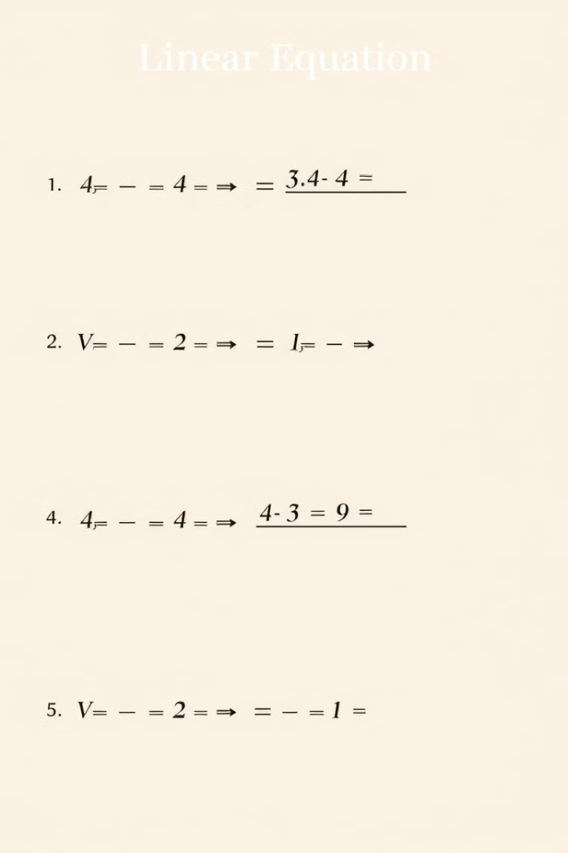



Solving Linear Equations
Isolate Variable
Perform inverse operations to isolate the variable on one side of the equation.
Solve for Value
Perform the necessary calculations to find the value of the variable.
Verify Solution
Substitute the found value back into the original equation to ensure it satisfies the equation.

Slide 4
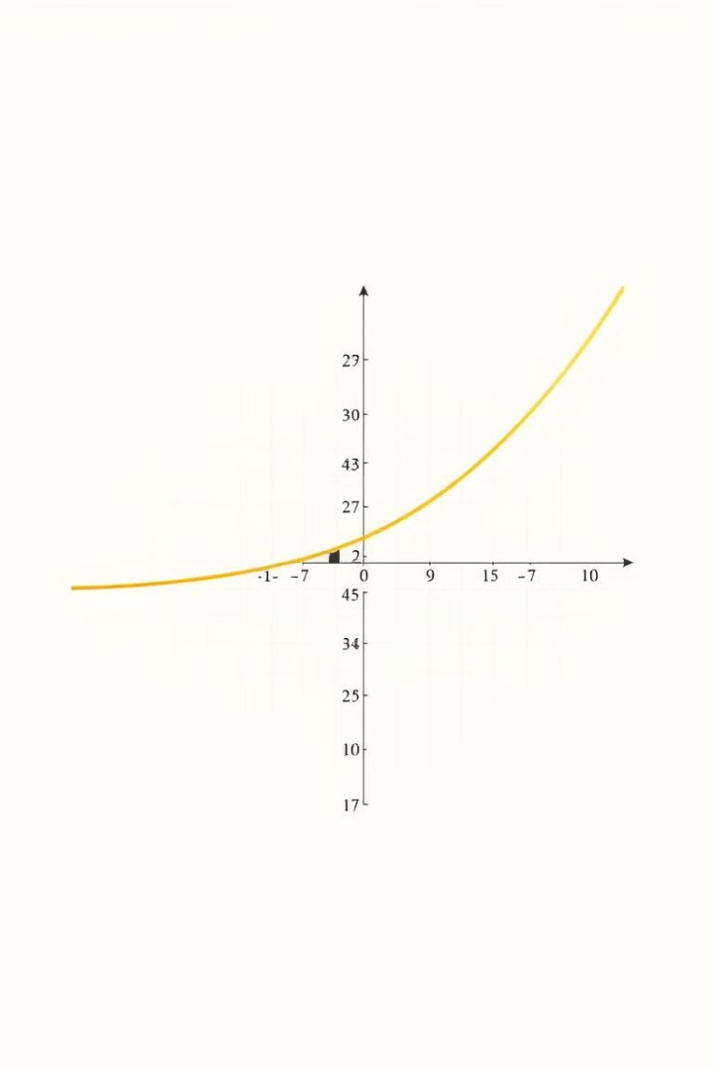
Solving Quadratic Equations
1
Factoring
Rewrite the equation in the form (x + a)(x + b) = 0 and solve for the roots.
2
Completing the Square
Manipulate the equation to form a perfect square, then solve for the variable.
3
Quadratic Formula
Use the formula x = (-b ± √(b^2 - 4ac)) / (2a) to find the solutions.

Slide 5
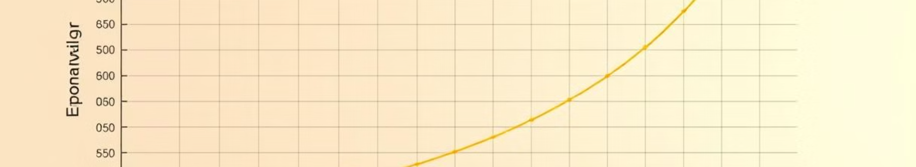
Solving Exponential Equations
Isolate the Exponent
Take the Logarithm
Rearrange the equation to isolate the variable in the exponent.
Apply the logarithm function to both sides of the equation to eliminate the exponent.
Solve for the Variable
Verify the Solution
Manipulate the logarithmic equation to find the value of the variable.
Substitute the found value back into the original exponential equation to ensure it is correct.

Slide 6
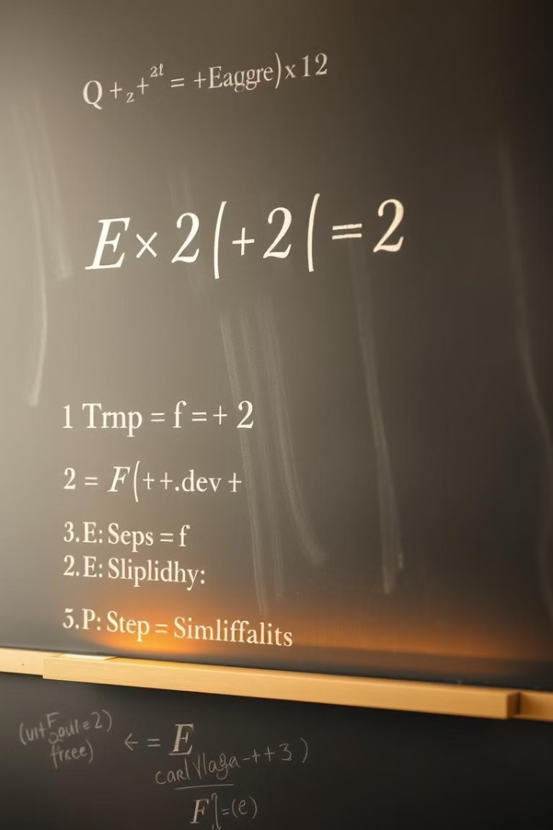




Techniques for Equation Simplification
Combine Like Terms
Distribute/Factor
Group together terms with the same variables and exponents.
Distribute or factor expressions to simplify the equation.
Substitute Variables
Solve for Variables
Replace variables with their equivalent expressions to reduce complexity.
Isolate variables and solve for their values to simplify the equation.

Slide 7
Graphing Equations to Visualize Solutions
Linear Equations
Quadratic Equations
Exponential Equations
Graphs of linear equations form straight lines, allowing for easy identification of solutions.
Graphs of quadratic equations are parabolic, revealing the number and nature of solutions.
Graphs of exponential equations display growth or decay patterns, providing insights into solution behavior.

Slide 8

Applications of Equation Solving in Real-World Scenarios
1
Scientific Modeling
2
Financial Calculations
Equation solving is crucial in fields like physics, chemistry, and engineering to model complex systems.
Solving equations is essential for making accurate financial projections, such as loan repayments and investment growth.
3
Optimization Problems
Equation solving techniques are used to find optimal solutions for resource allocation, production scheduling, and logistics.

